Slide 1

Lecture 35
DATA 8
Spring 2020
Classifiers

Slide 2
Announcements

Slide 3
Classifiers

Slide 4
Nearest Neighbor Classifier
NN Classifier Use the label of the most similar training example
Attributes of an example
Predicted label of the example
Population
Training
Set
Sample
Labels
Test
Set

Slide 5
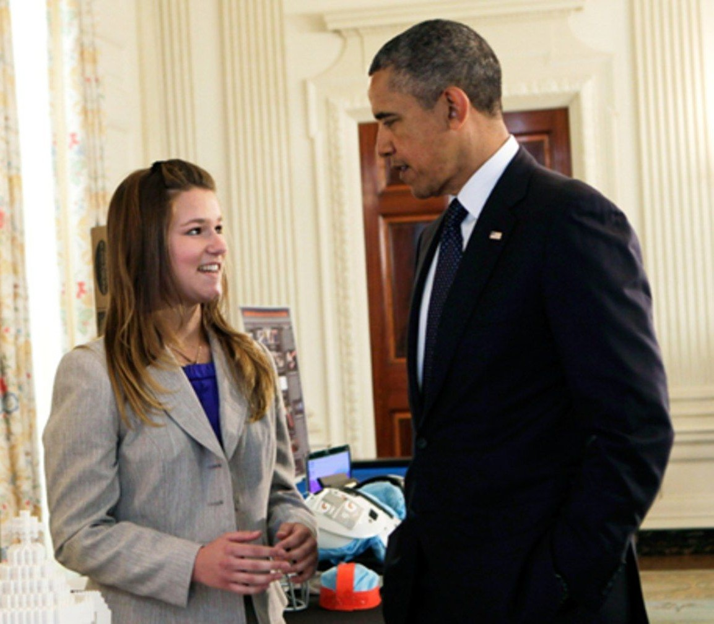
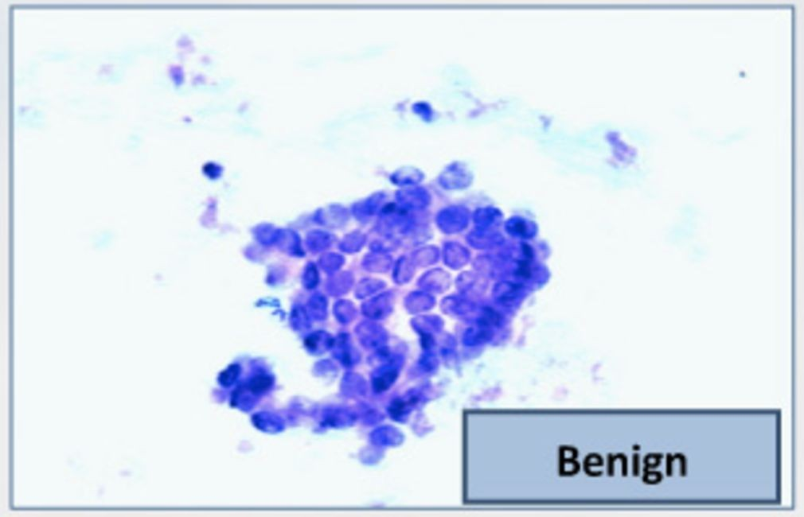
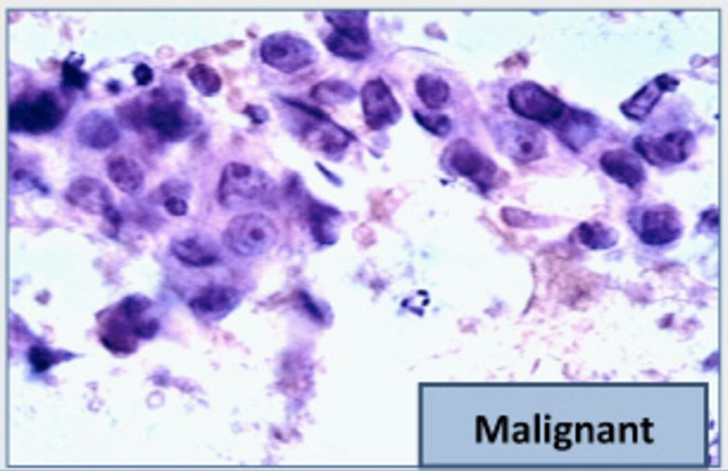
The Google Science Fair
Brittany Wenger, a 17-year-old high school student in 2012
Won by building a breast cancer classifier with 99% accuracy
(Demo)

Slide 6
Rows

Slide 7
Rows of Tables
Each row contains all the data for one individual
t.row(i) evaluates to ith row of table t
t.row(i).item(j)is the value of column j in row i
If all values are numbers, then np.array(t.row(i))
evaluates to an array of all the numbers in the row.
To consider each row individually, use
for row in t.rows:
... row.item(j) …
t.exclude(i)evaluates to the table t without its ith row

Slide 8
Distance

Slide 9
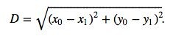
Pythagoras’ Formula
(x₀, y₀)
y₀ - y₁
(x₁, y₁)
x₀ - x₁

Slide 10
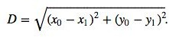
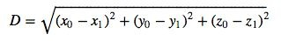
Distance Between Two Points
Two attributes x and y:
Three attributes x, y, and z:
(Demo)
and so on ...

Slide 11
Nearest Neighbors

Slide 12
Finding the k Nearest Neighbors
To find the k nearest neighbors of an example:
Find the distance between the example and each example in the training set
Augment the training data table with a column containing all the distances
Sort the augmented table in increasing order of the distances
Take the top k rows of the sorted table

Slide 13
The Classifier
To classify a point:
Find its k nearest neighbors
Take a majority vote of the k nearest neighbors to see which of the two classes appears more often
Assign the point the class that wins the majority vote
(Demo)

Slide 14
Evaluation

Slide 15
Accuracy of a Classifier
The accuracy of a classifier on a labeled data set is the proportion of examples that are labeled correctly
Need to compare classifier predictions to true labels If the labeled data set is sampled at random from a
population, then we can infer accuracy on that population
Sample | Labels
Training
Set
Test Set
(Demo)

Slide 16
Before Classifying

Slide 17
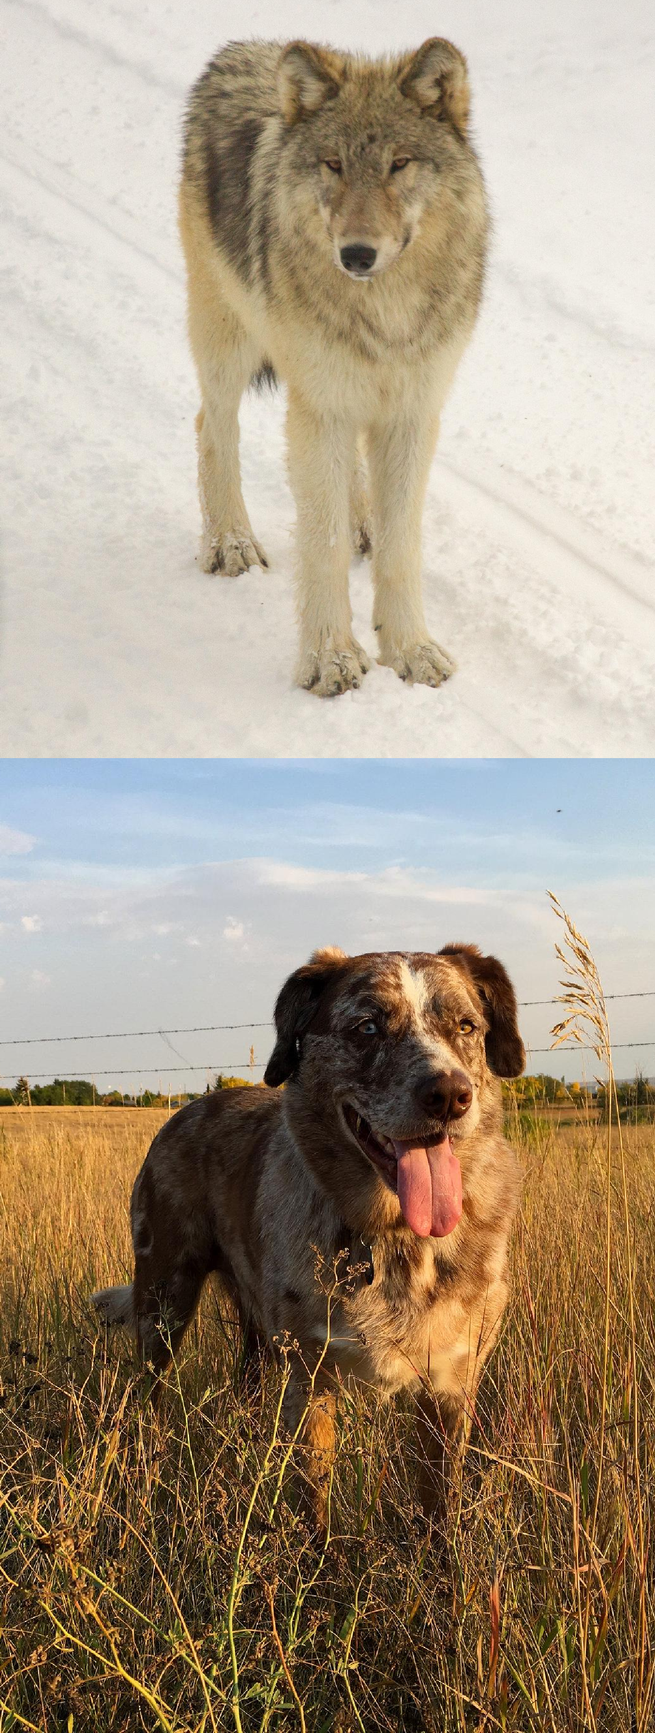
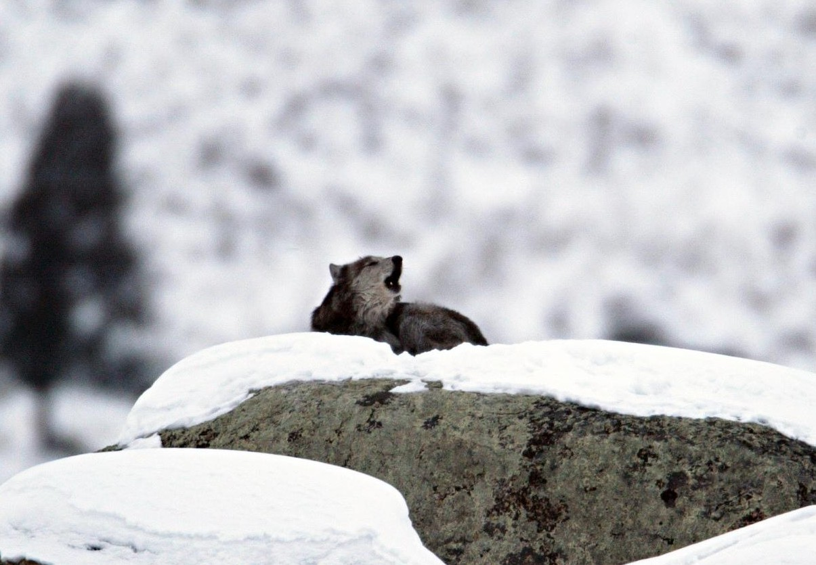
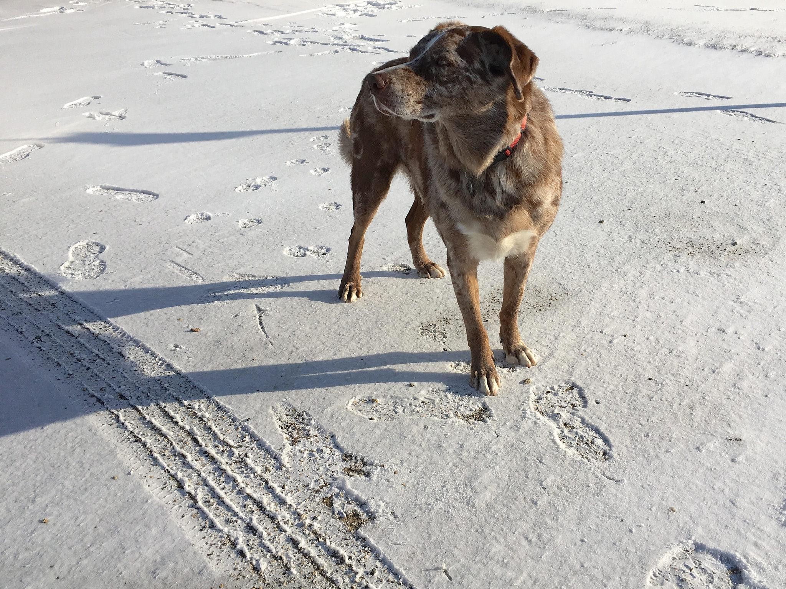
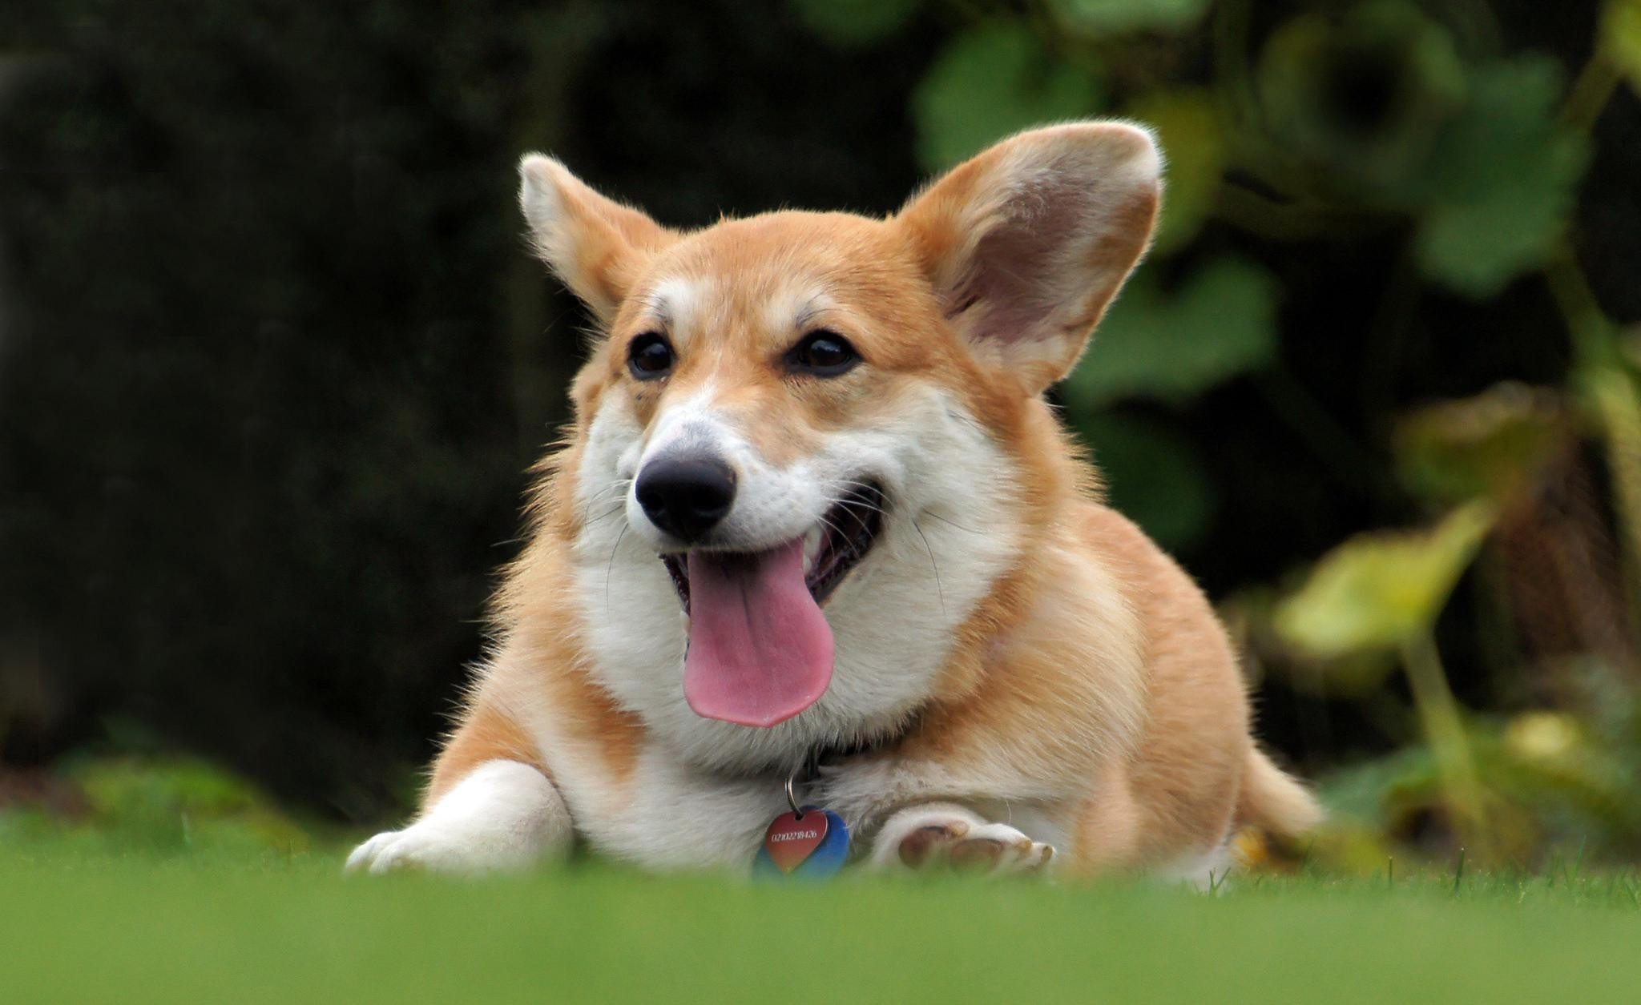
Dog or Wolf?

Slide 18
Start with a Representative Sample
Both the training and test sets must accurately represent the population on which you use your classifier
Overfitting happens when a classifier does very well on the training set, but can’t do as well on the test set

Slide 19
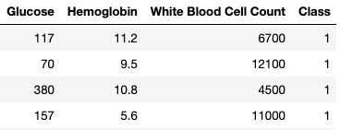
Standardize if Necessary
Chronic Kidney Disease data set
If the attributes are on very different numerical scales, distance can be affected
In such a situation, it is a good idea to convert all the
variables to standard units
(Demo)

